Slide 1
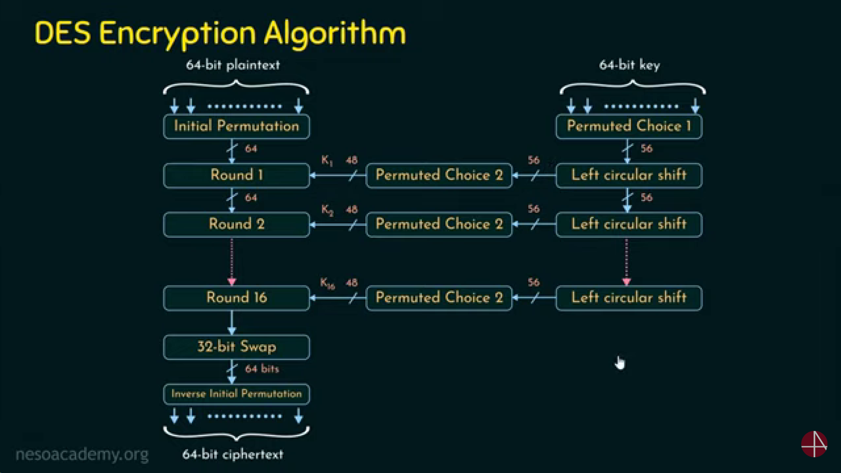
Feistel Cipher swapping
Input: 64bits
Output: 64bits
Mainkey: 64 bits
Subkey: 56bits
Roundkey: 48bits
No. of rounds: 16

Slide 2
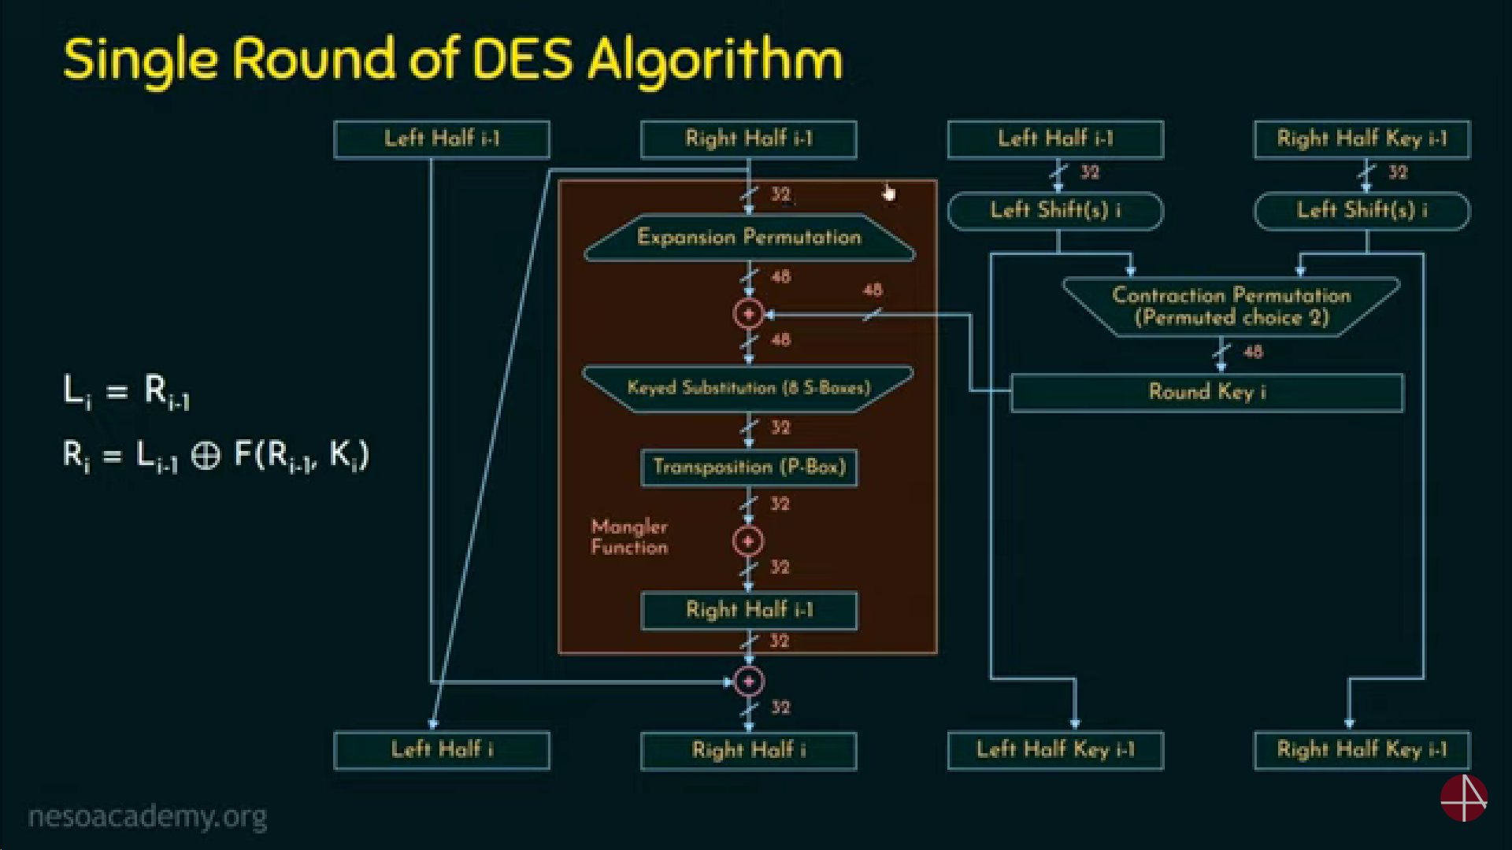

Slide 3
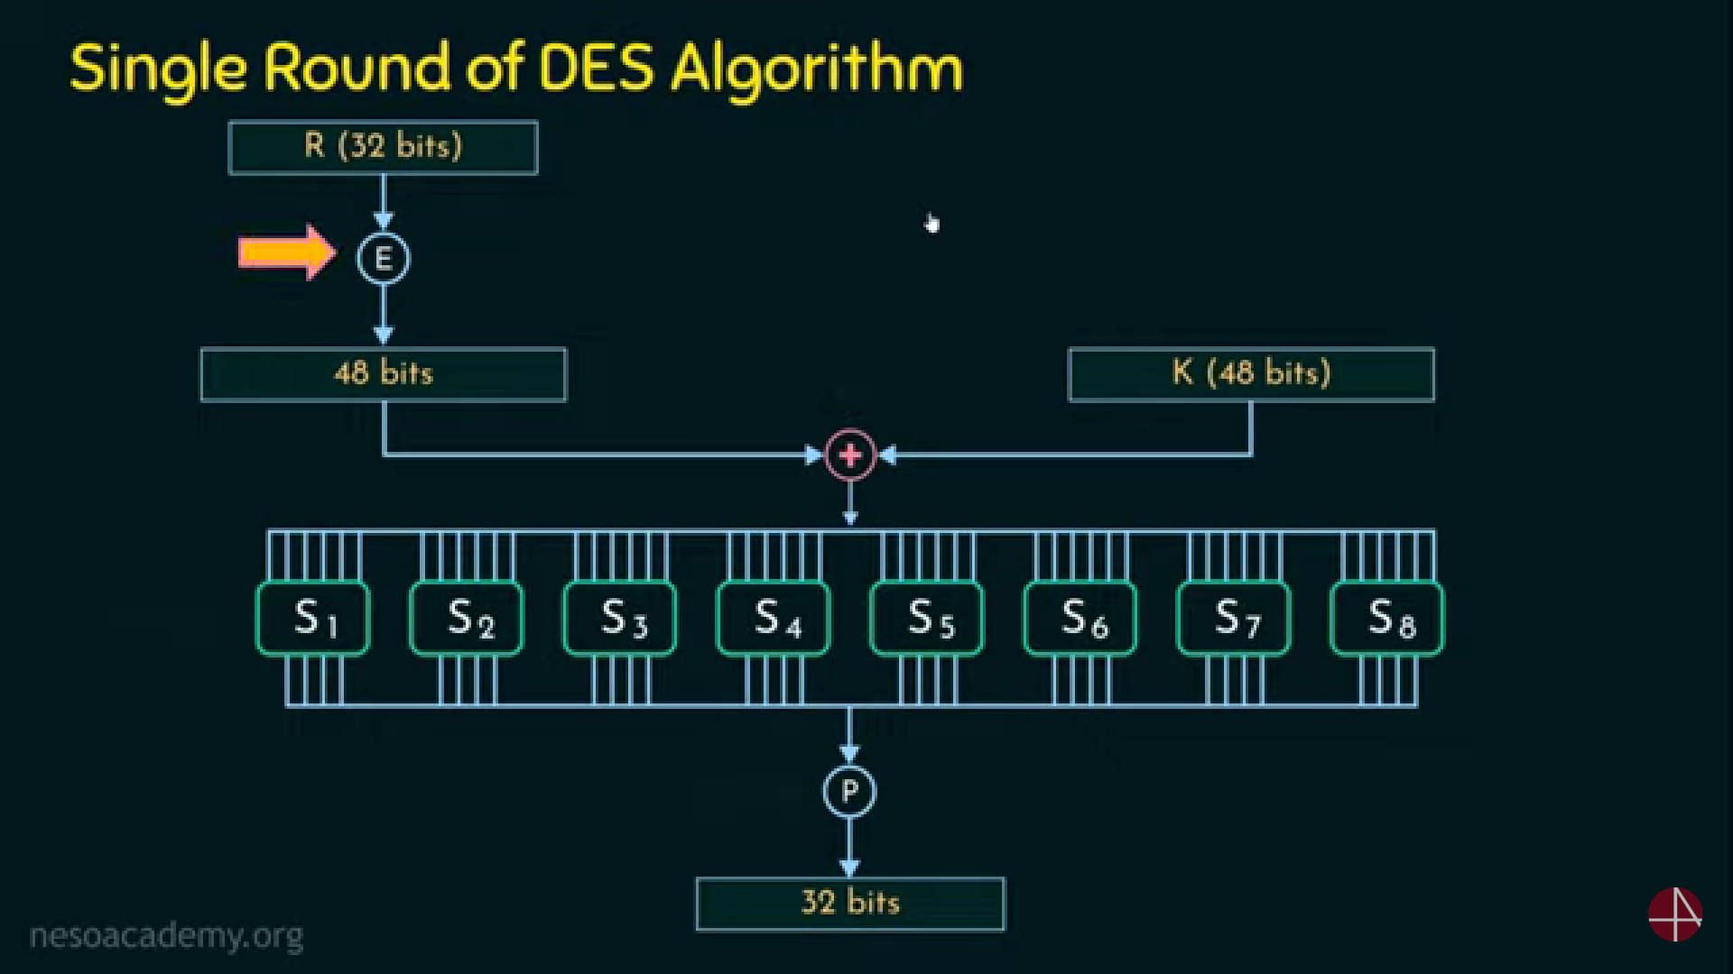

Slide 4
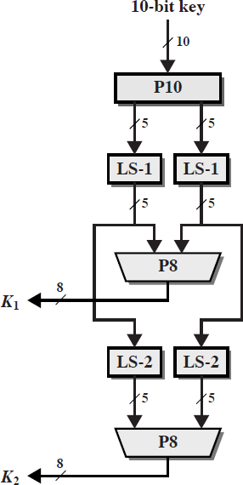
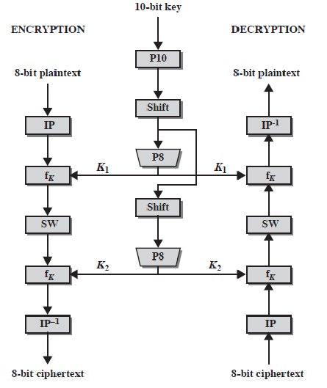
Simplified DES Algorithm

Slide 5



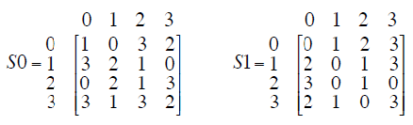

Plain Text- 10111101 Key- 1010000010
Obtaining K1 & K2 from main key:
Applying P10 on key, we get: 1000001100 (3rd bit comes first, 5th bit comes second, 2nd bit comes third and so on..)
Applying Circular left shift by 1 bit on two 5 bits part, we get: 10000 01100 = 00001 11000
Applying P8, we get K1=10100100 (6th bit comes first, 3rd bit comes second, 7th bit comes third and so on..)
Applying Circular left shift by 2 bits on step no. 2 (not K1), we get: 00001 11000 = 00100 00011
Applying P8, we get K2=01000011
Now we have: PT=10111101. Key=1010000010, K1=10100100 , K2=01000011
`
Steps for S-DES Encryption:
Initial permutation on plain text: IP(PT) = 01111110 (2nd bit comes first, 6th bit comes second, 3rd bit comes third and so on..)
Divide IP into 2 halves: left 4 bit get changed while right 4 bits remain unchanged after 1st round but right 4 bits go into F
fk1(01111110) = [(0111) XOR (F(1110,sk)) ,(1110)]
Apply E/P on 1110 we get: 0111 1101
After XOR with K1 = 1101 1001
Pass 1101 to S0 box and we get : 11
Pass 1001 to S1 box and we get : 10
Combining both results from S-boxes we get : 1110
Then applying P4 on it we get : 1011
This is our required F, that is, F(1110, sk) = 1101
E/P
4 | 1 | 2 | 3 | 2 | 3 | 4 | 1
The first and fourth input bits are treated as a 2-bit number that specify a row of the S-box, and the second and third input bits specify a column of the S-box
Eg: 1101 11 = 3rd row and 10 = 2nd column = 3 (from S0 table) = 11
Eg: 1001 11 = 3rd row and 00 = 0th column = 2 (from S1 table) = 10

Slide 6

fk1 (01111110) = [(0111) XOR (F(1110, K1)), (1110)]
= [(0111) XOR 1101), (1110)]
= [(1100), (1110)]
Applying SW we get: 1110 1100
fk2(11101100) = [(1110) XOR (F(1100,sk)) ,(1100)]
Apply E/P on 1100 we get: 0110 1001
XOR with K2: 0010 1010
Pass 0010 to S0 box and we get: 00
Pass 1010 to S1 box and we get: 00
Combining both results from boxes’ we get : 0000
Then Apply p4 on it we get: 0000
This is our required F, that is F(1100, sk) = 0000
fk2 (11101100) = [(1110) XOR (F(1100, K2)), (1100)]
= [(1110) XOR 0000), (1100)]
= [(1110), (1100)]
Now we have at the end: 1110 1100
Apply IP-1 on it we get: 0111 0101 which is our Cipher Text CT= 01110101
Practice Problems
Let the 8 - bits plain text be 10010111 and the 10 - bits key be 1010000010. Compute the cipher text using the Simplified - DES algorithm.
Let the 8 - bits plain text be 00101000 and the 10 - bits key be 1100011110. Compute the cipher text using the Simplified - DES algorithm.
E/P
4 | 1 | 2 | 3 | 2 | 3 | 4 | 1
https://youtu.be/mS2VC7vbbNc?si=zkuEnzCrdTCwoN4x
https://youtu.be/ewHnHWCsFNM?si=dXUiwzZ7Mk9cpa0b

Slide 7
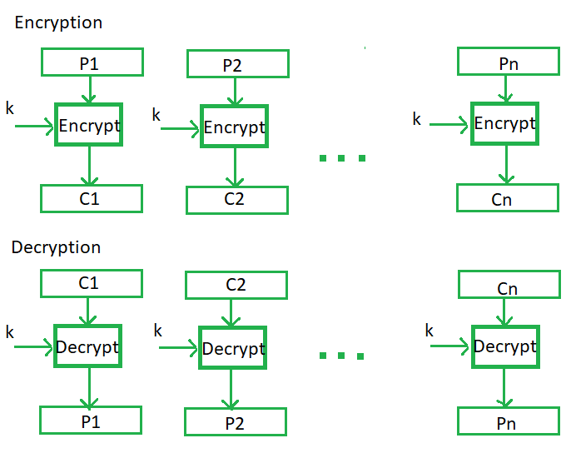
Electronic Code Book (ECB)
Electronic code book is the easiest block cipher mode of functioning. It is easier because of direct encryption of each block of input plaintext and output is in form of blocks of encrypted ciphertext. Generally, if a message is larger than b bits in size, it can be broken down into a bunch of blocks and the procedure is repeated.
Advantages and Limitations of ECB
Parallel encryption of blocks of bits is possible, thus it is a faster way of encryption.
Prone to cryptanalysis since there is a direct relationship between plaintext and ciphertext.

Slide 8
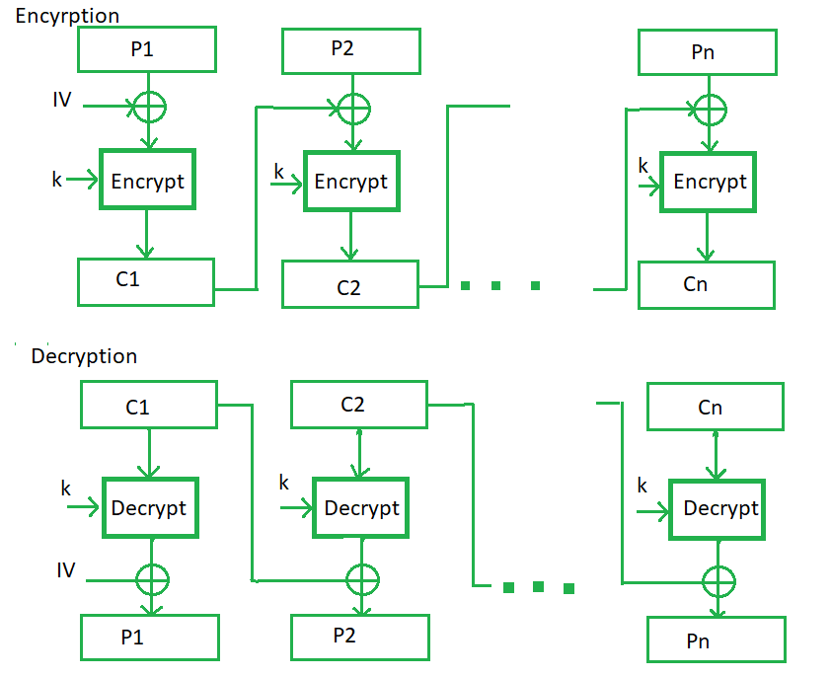
Cipher Block Chaining (CBC)
In CBC, the previous cipher block is given as input to the next encryption algorithm after XOR with the original plaintext block. In a nutshell here, a cipher block is produced by encrypting an XOR output of the previous cipher block and present plaintext block.
uses: bulk data encryption, authentication
Advantages and Limitations of CBC
Better resistive nature towards cryptanalysis than ECB.
need Initialization Vector (IV) which must be known to sender & receiver
Parallel encryption is not possible since every encryption requires a previous cipher.

Slide 9

Stream Modes of Operation
block modes encrypt entire block
may need to operate on smaller units
real time data
convert block cipher into stream cipher
cipher feedback (CFB) mode
output feedback (OFB) mode
counter (CTR) mode
use block cipher as some form of pseudo-random number
generator

Slide 10
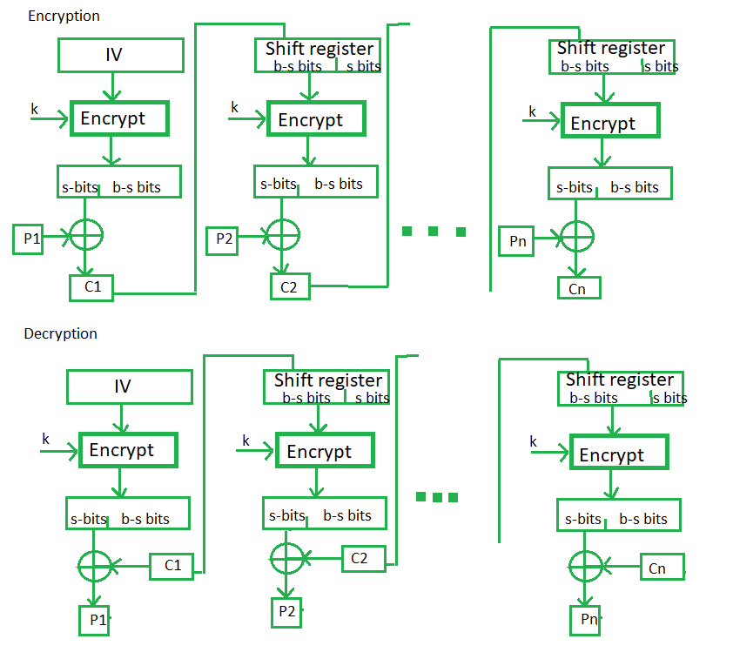
Cipher Feedback (CFB)
Cipher is given as feedback to the next block of encryption with some new specifications: initial vector IV is used for first encryption and output bits are divided as a set of L and R bits. L bits are selected along with plaintext bits to which an XOR operation is applied. The result is given as input to a shift register which swaps positions of L and R and the process continues.
Advantages and Limitations of CFB
appropriate when data arrives in bits/bytes (streams)
errors propagate for several blocks after the error

Slide 11
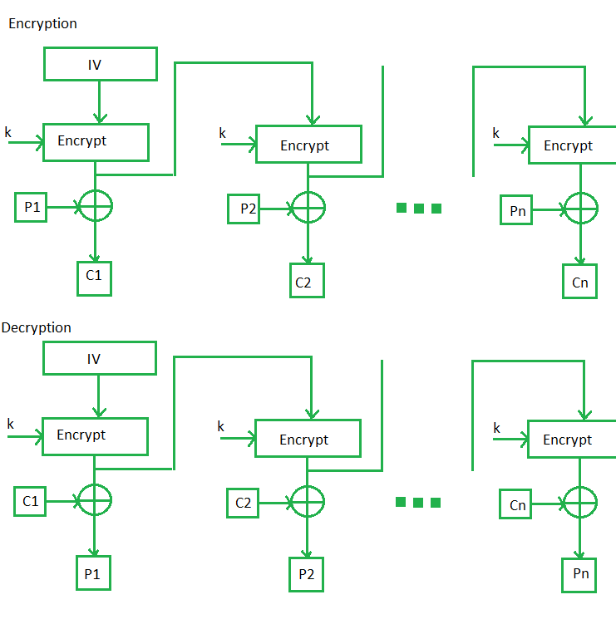
Output Feedback (OFB)
The output feedback mode follows nearly the same process as the Cipher Feedback mode except that it sends the encrypted output as feedback instead of the actual cipher which is XOR output. All bits of the block are sent instead of sending selected L bits. It also decreases the dependency or relationship of the cipher on the plaintext.
Advantages and Limitations of OFB
needs an IV which is unique for each use
bit errors do not propagate
More prone to modification attack
sender & receiver must remain in sync

Slide 12
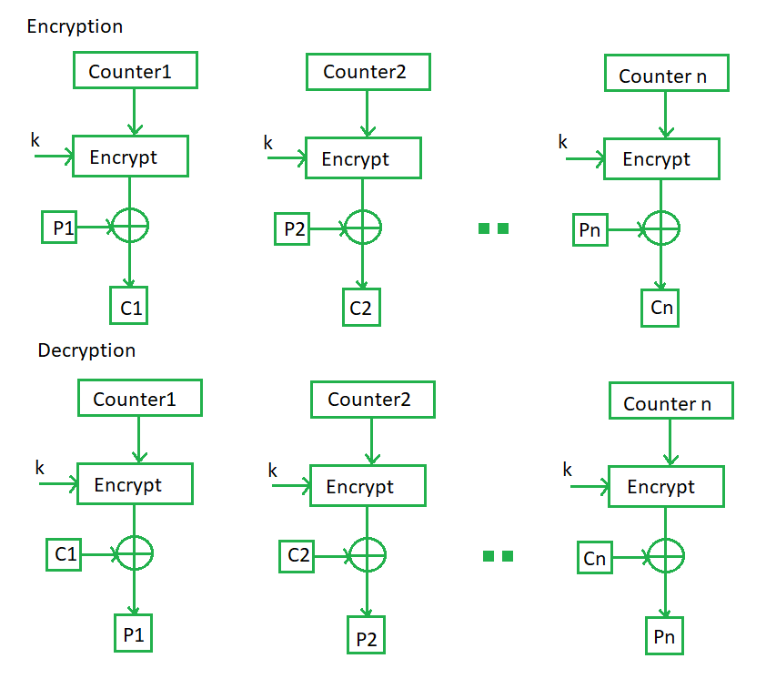
Counter (CTR)
Every time a counter-initiated value is encrypted and given as input to XOR with plaintext which results in ciphertext block. The CTR mode is independent of feedback use and thus can be implemented in parallel.
Advantages and Limitations of CTR
can do parallel encryptions
good for bursty high speed links
good security
but must ensure never reuse key/counter values, otherwise could break

Slide 13
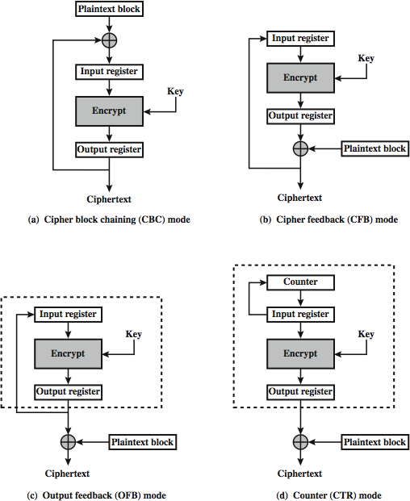
Feedback Characteristics

